Slide 1
INSTITUTIONAL
RETURN
ALPHA
Portfolio Optimizer
13.37%
+6.54%
Annual Forecast
vs Benchmark
Non-Linear Portfolio Construction for Alpha Generation & Systematic Risk Control
VOLATILITY
BETA
Tanmay Singh Soni | DTU — Software Engineering | 23/SE/208
13.30%
0.830
Link of Github
KEY THESIS Replacing emotional capital allocation with systematic portfolio construction
Annual Std Dev
Market Sensitivity
Notes:
SLIDE 1 — TITLE Business Problem: Most retail and semi-professional portfolios are constructed emotionally — stocks are picked for their stories, not their portfolio roles. Approach: This framework replaces subjective allocation with mathematical optimization, treating capital allocation as an engineering problem. Trade-off: Systematic frameworks sacrifice flexibility in favor of discipline and repeatability. IC Message: This is a portfolio construction project. The goal is to build an institutionally deployable portfolio that maximizes expected returns while remaining inside predefined risk budgets. It is NOT an AI stock picker or trading bot.

Slide 2
EXECUTIVE SUMMARY & PORTFOLIO SCORECARD
SLIDE 02
INVESTMENT PHILOSOPHY Risk is allocated first. Capital is allocated second. Objective: maximize risk-adjusted returns within predefined risk budgets.
13.37%
+6.54%
TARGET VS ACHIEVED SCORECARD
Metric | Target | Achieved | Status
Return Forecast | 12–14% | 13.37% | ✅
Alpha | 6–7% | 6.54% | ✅
Volatility | <14% | 13.30% | ✅
Drawdown | >-15% | -14.31% | ✅
Beta | 0.85–0.95 | 0.830 | ⚠️
Sharpe Ratio | >0.65 | 0.516 | ⚠️
Return Forecast
Expected Alpha
Annual Expected
vs Benchmark
13.30%
0.830
Portfolio Volatility
Portfolio Beta
Annual Std Dev
Market Sensitivity
-14.31%
0.694
Max Drawdown
Fund. Score
Peak-to-Trough
Weighted Average
KEY MESSAGE A successful portfolio is not one that maximizes every metric. It is one that remains inside its risk budgets while delivering attractive expected returns.
Notes:
SLIDE 2 — EXECUTIVE SUMMARY Business Problem: Investment committees need a clear, honest scorecard that shows what was targeted, what was achieved, and what trade-offs were made. Approach: All key metrics are presented with their pre-defined targets alongside actual results. Trade-offs are acknowledged rather than hidden. Trade-off: Beta (0.830 vs target 0.85-0.95) and Sharpe (0.516 vs target >0.65) both fell short. This was because achieving higher Beta/Sharpe would have required breaching volatility and drawdown budgets. IC Message: Portfolio management is a trade-off optimization problem. When risk budgets are tight, some metrics must be sacrificed. The optimizer prioritized capital preservation over maximizing every ratio.

Slide 3
TRANSLATING SECURITY RESEARCH INTO PORTFOLIO CONSTRUCTION
SLIDE 03
EXECUTIVE TAKEAWAY Investment ideas are inputs. Portfolio construction creates the final investment product.
Advisory Universe
16 securities from external research
External Research
6 Common
Holdings
Optimizer
Universe
Portfolio
Optimizer Portfolio
16 Securities
16 Securities
16 securities via mathematical optimization
37.5%
Alignment
Common Holdings
6 securities — validated by both approaches
Industry Research
Fundamental Screening
Optimization Engine
Portfolio Allocation
Independent Additions
10 optimizer-only positions for diversification
Research generates ideas. Portfolio construction determines how those ideas become investable, risk-controlled allocations.
Notes:
SLIDE 3 — RESEARCH TO CONSTRUCTION Business Problem: Raw research generates stock ideas — but ideas alone don't form a portfolio. This slide addresses the gap between 'which stocks' and 'how much of each stock'. Approach: External advisory recommendations were used as a quality benchmark. The optimizer independently solved the allocation problem using mathematical constraints. Trade-off: Only 37.5% overlap means the optimizer frequently disagreed with pure research-driven picks — prioritizing diversification and risk efficiency over conviction in any single name. IC Message: The optimizer is not competing with research analysts. It is solving the construction problem that follows from research. Security selection and portfolio construction are complementary, not competing.

Slide 4
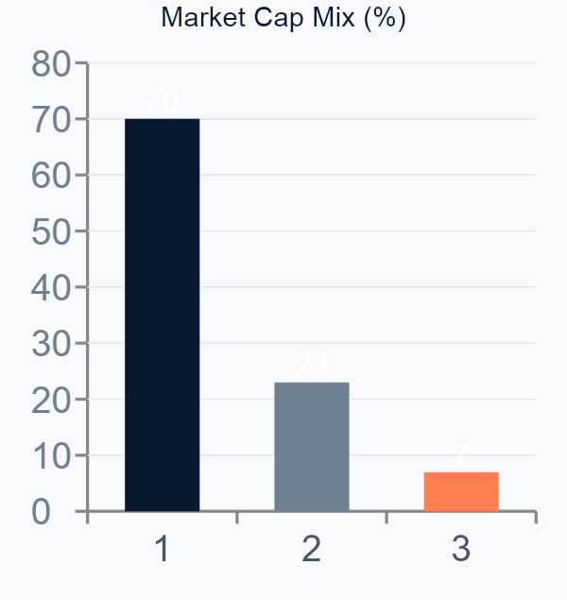
PORTFOLIO CONSTRUCTION ARCHITECTURE
SLIDE 04
EXECUTIVE TAKEAWAY Every security serves a predefined portfolio role. The portfolio is diversified by function, not merely by security count.
Core Compounders (~36.5%)
TACTICAL SATELLITES
Role: Volatility Anchor
~7% | Controlled Upside
Marico · Nestlé · Sun Pharma · ICICI Bank
Alpha Engines (~56.5%)
ALPHA ENGINES
Role: Primary Return Generation
Bharti Airtel · Atul · UltraTech · Choice Intl
~56.5% | Primary Return Generation
Tactical Satellites (~7%)
CORE COMPOUNDERS
Role: Controlled Upside
JSW Steel
~36.5% | Volatility Anchor & Fundamental Quality
Portfolio architecture allocates capital to layers by function — anchoring volatility with defensive quality, driving returns through high-conviction growth, and capping risk through satellite position limits.
Notes:
SLIDE 4 — ARCHITECTURE Business Problem: Investors often think diversification means 'many stocks.' True diversification means different portfolio roles — some holdings anchor volatility, some generate alpha, some provide tactical upside. Approach: The portfolio is structured as three functional layers, each with distinct mandates and size constraints. Trade-off: The 7% tactical satellite cap limits upside from cyclical names like JSW Steel, but also protects the portfolio from severe sector drawdowns. IC Message: Each position in this portfolio earns its place based on the role it serves. This is institutional portfolio architecture, not stock picking.

Slide 5
DEEP FUNDAMENTAL PRE-FILTRATION
SLIDE 05
EXECUTIVE TAKEAWAY Optimization begins only after quality control. The optimizer is never allowed to allocate capital to structurally weak businesses.
Broad Universe
QUALITY FILTRATION METRICS
500+ Stocks
Operating Margin
Profitability efficiency at operational level
Industry Screen
Revenue Growth
~120 Candidates
Sustainable top-line expansion trajectory
Debt-to-Equity
Fundamental Quality Filter
Balance sheet strength and leverage control
~40 Qualified
Return on Equity (ROE)
Shareholder value creation efficiency
Portfolio Holdings
ROCE
Capital deployment effectiveness
16 Securities
Industry Relative Quality
Peer benchmarking for sector context
Portfolio Weighted Avg
Fundamental Score
0.694
QUALITY THRESHOLD Fundamental Score < 0.45 → Automatically Eliminated
Notes:
SLIDE 5 — FUNDAMENTAL FILTRATION Business Problem: Mathematical optimizers can generate portfolios with very high allocations to fundamentally weak businesses if no quality gate exists. Garbage in, garbage out. Approach: A multi-factor quality scoring system screens every security before it enters the optimizer. Securities below the quality threshold are permanently excluded. Trade-off: The strict threshold eliminates some potentially high-return, low-quality names that a pure return-maximizer would select. IC Message: The optimizer is designed to build sustainable portfolios, not just high-return portfolios. Fundamental quality is the first risk control layer before mathematical optimization begins.

Slide 6
INSTITUTIONAL PORTFOLIO CONSTRUCTION FRAMEWORK
SLIDE 06
EXECUTIVE TAKEAWAY The optimizer allocates risk before allocating capital. Mathematical constraints enforce discipline that humans cannot maintain emotionally.
OPTIMIZATION ARCHITECTURE
PORTFOLIO CONSTRAINTS
Expected Return Vector
Industry Diversification
Max 2 securities per industry
Risk Constraints Applied
Concentration Limit
11.5% maximum allocation ceiling
SLSQP Primary Optimizer
Minimum Meaningful Weight
2.0% minimum allocation floor
Trust-Constr Fallback
Volatility Budget
Volatility target below 14.0%
Final Capital Allocation
Drawdown Budget
Max drawdown target above −15%
SLSQP Primary solver — Sequential Least Squares Programming. Trust-Constr Fallback for complex constraint convergence. Both engines ensure feasible, risk-bounded allocations.
Notes:
SLIDE 6 — CONSTRUCTION FRAMEWORK Business Problem: Without mathematical constraints, portfolio construction is subject to behavioral biases — overconcentration, sector tilts, and ignoring downside risk. Approach: Two industry-standard optimization algorithms (SLSQP and Trust-Constr) are applied in sequence, with hard constraints on volatility, drawdown, concentration, and industry exposure. Trade-off: Stricter constraints reduce the optimizer's degrees of freedom, potentially leaving return on the table. The optimizer may not find the globally maximum-return portfolio — but it finds the best portfolio within the defined risk envelope. IC Message: The constraint set is what makes this portfolio deployable for an institutional investor. Anyone can build a high-return backtest. Building a constrained, risk-budgeted portfolio is much harder.

Slide 7
RISK BUDGETING FRAMEWORK
SLIDE 07
EXECUTIVE TAKEAWAY Portfolio risk is treated as a finite resource that must be allocated intentionally — not a residual outcome of security selection.
RISK BUDGET TARGETS
BUDGET UTILIZATION
Risk Metric | Budget | Achieved | Utilization
Volatility | < 14.0% | 13.30% | 95%
Max Drawdown | > −15.0% | −14.31% | 95%
Portfolio Beta | 0.85–0.95 | 0.830 | Trade-off
Concentration | Max 11.5% | Controlled | ✅
Industry Exp. | Max 2/sector | Achieved | ✅
Volatility Budget
13.30% / 14.00% → 95% utilized
Drawdown Budget
−14.31% / −15.00% → 95% utilized
KEY INTERPRETATION
The optimizer intentionally utilized 95% of both risk budgets — extracting maximum return within defined boundaries without breaching any limit.
Risk budgeting converts qualitative investment policy statements into quantitative constraints. The optimizer treats risk as a scarce resource — allocating it deliberately, not accidentally.
Notes:
SLIDE 7 — RISK BUDGETING Business Problem: Most portfolios treat risk as a residual — you pick stocks, and then you discover the risk. Professional portfolio management does the opposite. Approach: Risk budgets are defined before any security is selected. The optimizer then maximizes return within those budgets. Trade-off: Using 95% of both budgets means the portfolio is close to the edge of its tolerance. This was deliberate — leaving excessive safety margin would have unnecessarily reduced expected returns. IC Message: 95% budget utilization is a sign of efficiency, not recklessness. The optimizer found the maximum return achievable without breaching any risk constraint.

Slide 8
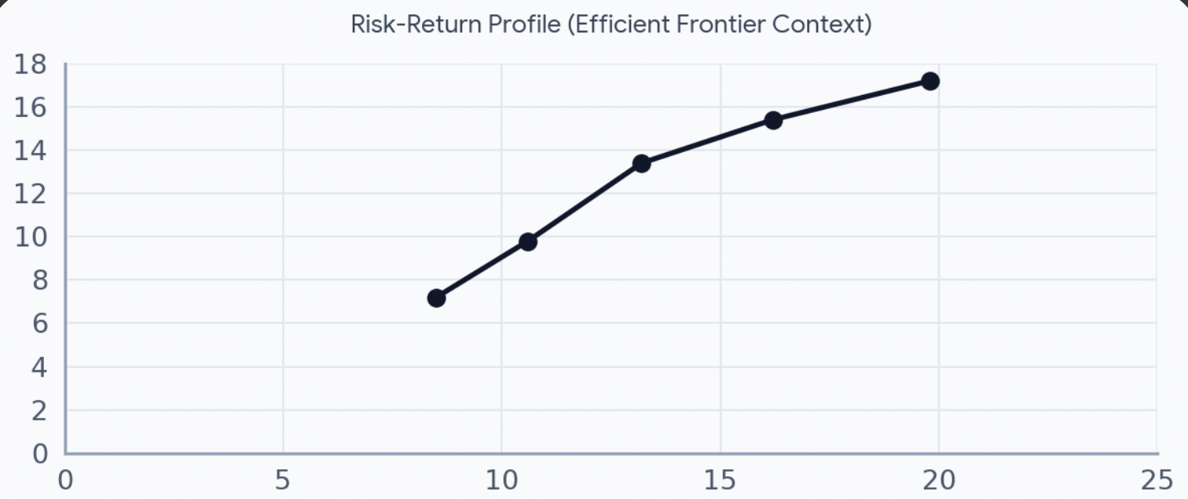
CAPITAL PRESERVATION AS A FIRST PRINCIPLE
SLIDE 08
EXECUTIVE TAKEAWAY Avoiding severe capital impairment is prioritized over maximizing market exposure. Lower Beta was a deliberate outcome of the capital preservation mandate.
−14.31%
−1.34%
13.30%
THE VOLATILITY PARADOX
Max Drawdown
Daily VaR (95%) [A7]
Portfolio Volatility
Beta
Target: 0.85–0.95
⚠️ Trade-off
Achieved: 0.830
Sharpe Ratio
Target: > 0.65
⚠️ Trade-off
Achieved: 0.516
Simulation testing showed Beta >0.90 and Sharpe >0.65 required Volatility >15% and drawdowns beyond acceptable limits. The optimizer shifted capital to defensive FMCG and Healthcare.
The Beta and Sharpe shortfalls are not failures — they are the cost of maintaining drawdown discipline. The optimizer correctly determined that capital preservation outweighed exposure maximization.
Notes:
SLIDE 8 — CAPITAL PRESERVATION Business Problem: Maximizing Sharpe or Beta in isolation can lead to unacceptable drawdowns. Institutional mandates require that capital is protected from catastrophic losses. Approach: The optimizer was explicitly programmed to prioritize drawdown control over market-sensitivity maximization. When simulation showed that higher Beta/Sharpe required violating risk budgets, the optimizer shifted capital to defensive sectors. Trade-off: Beta (0.830) and Sharpe (0.516) both fell short of targets. This was accepted because the alternative would have breached drawdown constraints. IC Message: Institutional portfolio management means accepting that some individual metrics will be sacrificed to maintain the overall risk framework. The portfolio did exactly what it was designed to do.

Slide 9
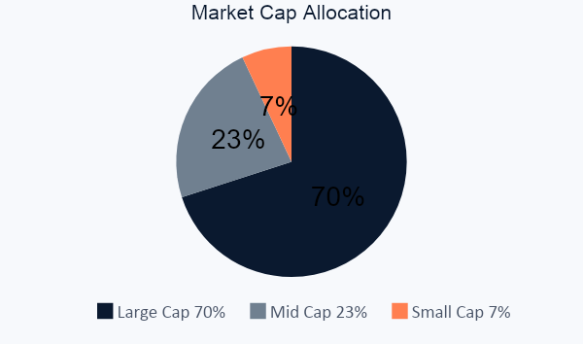
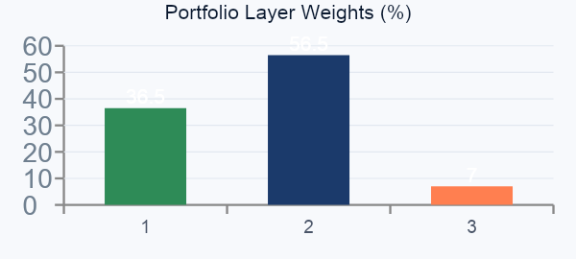
FINAL TARGET-LOCKED PORTFOLIO
SLIDE 09
EXECUTIVE TAKEAWAY Every allocation reflects a balance between conviction, diversification, and risk control. No position is held arbitrarily.
Security | Alloc. | Layer | Sector | Beta | F.Score
Bharti Airtel | 11.5% | Alpha Engine | Telecom | 1.05 | 0.74
Atul Ltd | 10.2% | Alpha Engine | Chemicals | 0.88 | 0.71
UltraTech Cement | 9.8% | Alpha Engine | Materials | 1.12 | 0.69
Choice Intl | 8.9% | Alpha Engine | NBFC | 1.21 | 0.65
Eicher Motors | 7.4% | Alpha Engine | Auto | 0.95 | 0.72
Marico | 7.2% | Core Compounder | FMCG | 0.65 | 0.75
Sun Pharma | 6.8% | Core Compounder | Pharma | 0.72 | 0.78
JSW Steel | 7.0% | Tactical Satellite | Metals | 1.35 | 0.62
ICICI Bank | 6.5% | Core Compounder | Banking | 1.08 | 0.73
AIA Engineering | 5.5% | Alpha Engine | Industrials | 0.82 | 0.68
3M India | 5.2% | Alpha Engine | Diversified | 0.76 | 0.70
Bosch | 4.8% | Alpha Engine | Auto Anc. | 0.85 | 0.71
Lupin | 3.9% | Core Compounder | Pharma | 0.68 | 0.71
Nestlé India | 3.6% | Core Compounder | FMCG | 0.55 | 0.72
Power Grid | 3.3% | Core Compounder | Utilities | 0.60 | 0.76
Pidilite | 2.4% | Alpha Engine | Chemicals | 0.90 | 0.69
Notes:
SLIDE 9 — FINAL PORTFOLIO Business Problem: An investment committee needs to see the actual portfolio — not just the methodology. Each allocation must be defensible and transparent. Approach: All 16 holdings are presented with their allocations, portfolio role, sector, beta, and fundamental score. The portfolio is 70% large cap for stability, 23% mid cap for alpha, and 7% small cap for controlled upside. Trade-off: The 2-per-sector constraint means some sectors are underweighted relative to a benchmark, and some attractive names may be excluded because their sector is already full. IC Message: This is not a random collection of stocks. Every position has a defined role, a size limit, and a quality threshold. The portfolio is fully transparent and auditable.

Slide 10
INVESTMENT LIFECYCLE & SCALABILITY
SLIDE 10
EXECUTIVE TAKEAWAY The framework replicates a complete institutional investment workflow — from data ingestion to performance attribution.
INVESTMENT LIFECYCLE
TECHNOLOGY STACK
SCALABILITY FEATURES
Research Universe
Portfolio Optimization
Python
Dynamic data ingestion
NumPy
Automated quality scoring
Fundamental Screening
Allocation Engine
Pandas
Systematic construction
Quality Scoring
Monitoring & Rebalancing
SciPy (SLSQP)
Continuous risk monitoring
yFinance
Rebalancing support
Risk Assessment
Performance Attribution
Requests
Performance attribution
INVESTMENT COMMITTEE FINAL STATEMENT
Repository
The optimizer was designed to maximize expected returns while respecting risk budgets, diversification requirements, and capital preservation objectives. Evaluate success by risk-budget adherence, not metric maximization.
Link of Github
Notes:
SLIDE 10 — LIFECYCLE & SCALABILITY Business Problem: A one-time portfolio construction is not investable at scale. Institutional frameworks require repeatable, automated, and auditable workflows. Approach: The framework is built as a complete investment lifecycle — from universe definition through rebalancing and attribution — using production-grade Python libraries. Trade-off: Automation introduces model risk. A fully systematic process can make systematic errors. This is why the fundamental quality gate exists — to prevent the optimizer from entering structurally bad positions. IC Message: This framework is not a class project. It is an institutional-grade portfolio construction system that could, with appropriate data and infrastructure investment, be deployed in a professional asset management context. It demonstrates command of the full investment lifecycle, not just the optimization step.

